Slide 1
SINAMICS S120 The flexible and modular drive for demanding applications
www.siemens.com/sinamics-s120
Unrestricted © Siemens 2020

Slide 2
Table of contents
1
Introduction
2
Single-axis drives AC/AC
3
Multi-axis drives DC/AC
4
SINAMICS S120M distributed servo drive
5
SIMOTICS motors & DRIVE-CLiQ
6
Communication
7
Safety Integrated
8
Firmware functionality
9
Engineering tools
10
Digitalization
11
Support

Slide 3
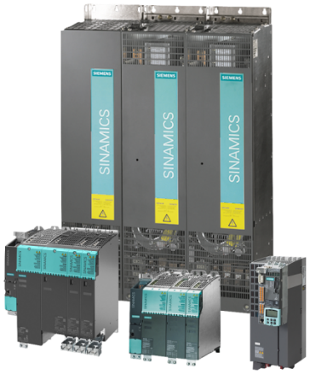
SINAMICS S120 – the modular drive system for applications at the highest level
SINAMICS S120 offers solutions for high-performance single and multi-axis drives
Detailed description:
Power range: 0.12 kW – 5700 kW
Servo /vector control, V/f control
Integrated safety and positioning functions
Additional motion control functions in conjunction with SIMOTION or SINUMERIK
High degree of scalability, flexibility and combinability
Energy efficiency as a result of the energy recovery capability and/or common DC link
Communication: PROFIBUS / PROFINET / EtherNet/IP / CANopen / Modbus TCP
Advanced Technology Functions for individual – and at the same time – efficient drive solutions (DCC and TEC)
SINAMICS web server for efficient diagnostics and maintenance

Slide 4
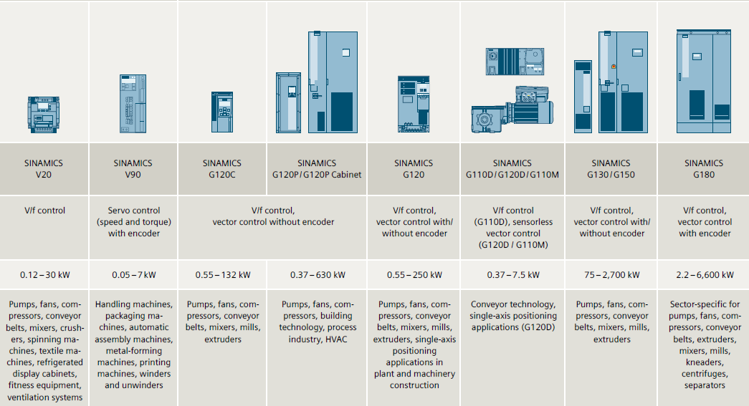
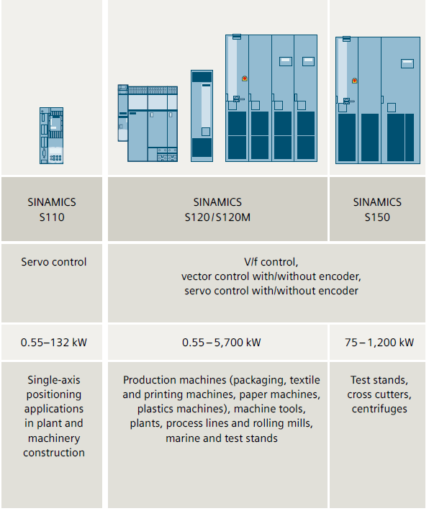
SINAMICS S120 Positioning in the SINAMICS portfolio
Low voltage AC devices
converters
servo and high-performance drives
S120 servo drives / high-performance drives
Single-axis drives AC/AC |  | Multi-axis drives DC/AC
Blocksize format 0.55 … 4 kW (1/3AC 200 V) 5.5 … 55 kW (3AC 200 V) 0.55 … 250 kW (3AC 400 V) 7,5 … 250 kW (3AC 690 V) | Chassis format 110…400 kW (3AC 400 V) 400…560 kW (3AC 400 V) | Booksize & Booksize Compact formats 1,6…107 kW (3AC 400 V) | Chassis format 110…3040 kW (3AC 400 V) 75… 5700 kW (3AC 690 V)

Slide 5
Table of contents
1
Introduction
2
Single-axis drives AC/AC
3
Multi-axis drives DC/AC
4
SINAMICS S120M distributed servo drive
5
SIMOTICS motors & DRIVE-CLiQ
6
Communication
7
Safety Integrated
8
Firmware functionality
9
Engineering tools
10
Digitalization
11
Support

Slide 6

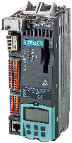



SINAMICS S120 single-axis drive AC/AC System components for the Blocksize and Chassis formats
Control Unit
(identical for Blocksize and Chassis formats)
Power Modules
Options
PM240-2
Blocksize format
Air-cooled modules
Power Module
Chassis format
Liquid and water-cooled modules
CU310-2
BOP-2
(for operating
the CU320-2)
CUA31; CUA32 (expansion for multi-axis applications)
PM240-2 FSC with CU310-2
SIMOTION 410
Definition liquid and water cooling see page 53/54
Power Module
Chassis

Slide 7
Control Units Single-axis drives AC/AC
www.siemens.com/sinamics-s120
Unrestricted © Siemens 2021

Slide 8
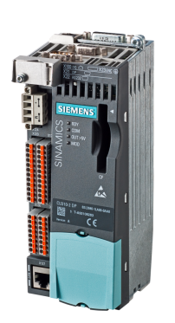
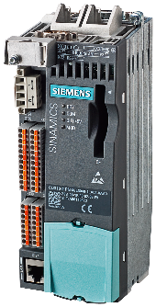
CU310-2 Control Unit
Designed for operation with a Power Module in the Blocksize or Chassis format
Detailed description:
Open-loop and closed-loop control functions of the drive in CU310-2 PN
CU controls Power Modules Blocksize via the PM-IF interface, and is directly mounted onto the Power Module.
CU controls Power Modules Chassis via the DRIVE-CLiQ interface. It is mounted directly next to the Power Modules in the control cabinet.
The CU310-2 offers functions from a basic speed controller up to extensive positioning functions
Available in two versions: CU310-2 PN with integrated PROFINET interface and CU310-2 DP with PROFIBUS DP connection
Drive-related inputs/outputs in the CU can be linked using BICO technology
Firmware and the parameters that have been set are on the Compact flash card
CU310-2 PN
CU310-2 DP

Slide 9
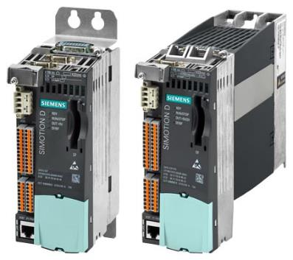
SIMOTION D410-2
Designed for operation with a Power Module in the Blocksize or Chassis format
Detailed description:
For single-axis drives with multi-axis option (2-3 axes) in the Blocksize format
Available as PROFIBUS and as PROFIBUS/PROFINET version
Specifically for SINAMICS S120 PM240-2 Power Modules
For motion control, technology and PLC functions – as well as closed-loop drive control for an axis
D410-2 Control Units support motion control with positioning (POS), synchronous operation/electronic gear (GEAR), cam (CAM) and path interpolation (PATH) technology functions.
Applications for SIMOTION D410-2 include, for example, independent control of single axes, cross-cutters and winder applications.
SIMOTION D410-2 Control Unit, on a mounting plate and plugged onto a Power Module

Slide 10
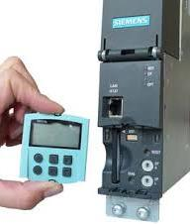
BOP20 Basic Operator Panel
BOP20 – facilitates simple operation of the Control Unit
Detailed description:
With the BOP20 Basic Operator Panel, faults can be acknowledged, parameters set and diagnostics information read-out.
The BOP20 Basic Operator Panel can be snapped onto any CU310-2 or CU320-2 Control Unit.
The BOP20 Basic Operator Panel has a backlit two-line display area and 6 keys.
The integrated plug connector on the rear of the BOP20 Basic Operator Panel provides its power and establishes communication with the Control Unit.

Slide 11
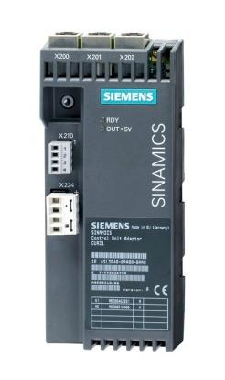
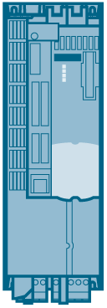


CUA31 Control Unit Adapter
CUA31 facilitate multi-axis applications with SINAMICS S120 AC/AC Power Modules
Detailed description:
An AC/AC Power Module is connected to a multi-axis Control Unit (e.g. a CU320-2) via the CUA31 CU adapter and the DRIVE-CLiQ interface. The Control Unit handles the drive functions for the AC drive.
The Control Unit Adapter can be plugged onto the Power Modules in the Blocksize format.
CU320-2
PM 240-2 Power Modules with snapped-on CUA31 Control Unit Adapter

Slide 12
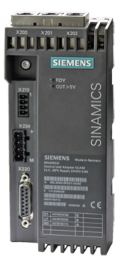

CUA32 Control Unit Adapter
CUA32 facilitate multi-axis drives with SINAMICS S120 AC/AC Power Modules
Detailed description:
An AC/AC Power Module is connected to a multi-axis Control Unit (e.g. a CU320-2) via the CUA32 CU adapter and the DRIVE-CLiQ interface. The Control Unit handles the drive functions for the AC drive.
The Control Unit Adapter can be plugged onto the Power Modules in the Blocksize format.
In comparison to the CUA31, the CUA32 also has an integrated HTL/TTL encoder interface to connect an external encoder.
CU320-2
PM 240-2 Power Modules with snapped-on CUA32 Control Unit Adapter

Slide 13
Power Modules Single-axis drives AC/AC
www.siemens.com/sinamics-s120
Unrestricted © Siemens 2021

Slide 14



Overview of the Power Modules
 | Format PM240-2 Blocksize | Chassis format (air cooled) | Chassis format (liquid cooled) | Chassis format (water cooled)
Line voltage/power ranges
1AC 200 – 240V +/-10% 3AC 200 – 240V +/-10% 3AC 380 – 480V +/-10% 3AC 500 – 690V +/-10% | 0.55 … 4kW 0.55 … 7.5kW 0.55 … 250kW 11 … 250kW | - - 110 … 250kW - | - - 110 … 400kW 400… 560kW* | - - 110 … 400kW 400… 560kW*
Power factor | 0.7 … 0.93 | 0.75 ... 0.93 | 0.75 ... 0.93 | 0.75 ... 0.93
Pulse frequency | 2 kHz/4kHz | 2 kHz | 1.25 kHz or 2kHz (-250kW) | 1.25 kHz or 2kHz (-250kW)
Degree of protection | IP20 | IP20 | IP20 (without taking into consideration of the connecting bars) | IP20 (without taking into consideration of the connecting bars)
Radio interference suppression (IEC 61800-3) | Category C2 | Category C3 | Category C3, at 690V Category C2 | Category C3, at 690V Category C2
Braking method | Braking resistor | Braking resistor | Braking resistor | Braking resistor
PM240-2 FSC with CU310-2

Slide 15
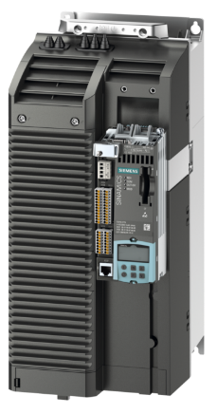
PM240-2 Power Modules Blocksize format – air cooled
Line-side infeed and motor-side power unit in one device
Detailed description:
Comprises a line rectifier, a DC link and an inverter to supply a motor.
For drives designed without energy recovery into the line supply, the energy when generating is converted into heat in the braking resistors.
Communication via PM-IF interface with the CU310-2 Control Unit, SIMOTION D410-2 or CUA31/CUA32 Control Unit Adapter.
The PM240-2 Power Modules are designed for installation in the cabinet and in the following cooling variants:
Chassis device with internal air cooling
Push-through device with external air cooling
Can be connected to grounded TN/TT and ungrounded IT line systems.

Slide 16
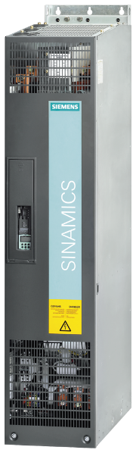
Power Modules Chassis format – air cooled
Line-side infeed and motor-side power unit in one device
Detailed description:
Communication via DRIVE-CLiQ with the Control Unit.
CU310‑2
CU320‑2
SIMOTION D
Can be used in multi-axis systems in conjunction with a CUA31 CU adapter
Comprises a line rectifier, a DC link and an inverter to supply a motor.
For drives designed without energy recovery into the line supply, the energy when generating is converted into heat in the braking resistors.
Can be connected to grounded TN/TT and ungrounded IT line systems.

Slide 17
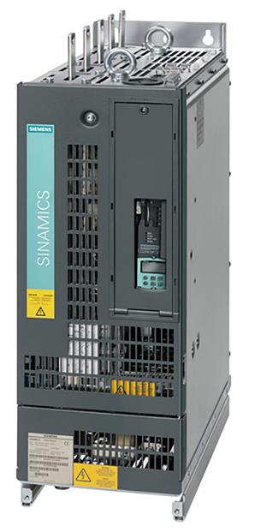
Power Modules Chassis format – liquid cooled and water cooled
The power unit for high power ratings and Unrestricted installation space
Detailed description:
Communication via DRIVE-CLiQ with the Control Unit. CU310‑2 ; CU320‑2: SIMOTION D
Comprises a line rectifier, a DC link and an inverter to supply a motor.
For drives designed without energy recovery into the line supply, the motor produces energy when braking and a Braking Module with braking resistors is required.
Predestined for applications where installation space is Unrestricted or harsh environmental conditions prevail. High degrees of protection up to IP55 can be implemented.
Compact design, lower weight when compared to air-cooled devices
Quiet as there is only the fan for the electronics.
Very efficient cooling / heat dissipation

Slide 18
Options / accessories – Blocksize format
www.siemens.com/sinamics-s120
Unrestricted © Siemens 2021

Slide 19
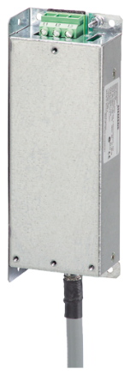
Line filters for the Blocksize format
To achieve higher radio interference suppression classes
Detailed description:
The Power Modules PM 240-2 are available in versions with and without integrated line filter.
With an additional optional line filter, the Power Modules achieve a higher radio interference suppression class.
When using third-party filters, motor cable lengths longer than those specified in the catalog can be achieved.

Slide 20
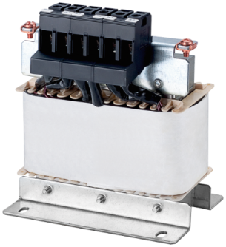
Line reactors for the Blocksize format
Line reactors smooth the current drawn up by the converter
Detailed description:
Line reactors limit the low-frequency harmonic effects and reduce the load on the other loads in the same supply system.
In addition, the line reactors limit the current spikes at the converter input, e.g. for commutation notches.
A DC link reactor is integrated in the PM240‑2 Power Modules FSD to FSF and therefore no line reactor is required.

Slide 21
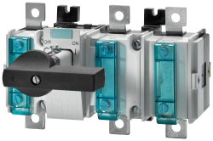

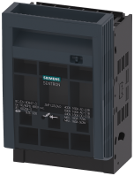
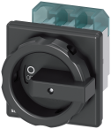
Recommended line-side power components for devices in the Blocksize format
Siemens offers various line-side components in combination for the S120 drive system
Isolated load disconnector*
LV HRC fuses*
Load disconnector with fuse*
Main and EMERGENCY OFF switch*
*Additional information in Catalog D 21.4

Slide 22
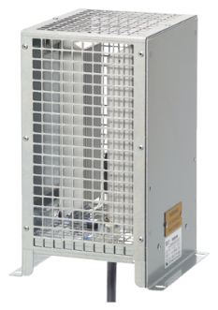
Braking resistors for the Blocksize format
To reduce excess energy from the DC link
Detailed description:
Excess energy from regenerative operation is converted into thermal energy
The braking resistors are intended for Power Modules PM 240-2, which feature an integrated braking chopper.
Braking resistors can be installed next to Power Modules.
The braking resistors for the Power Modules sizes FSD to FSF should be positioned outside the control cabinet or outside the electrical room → Reduction of the air-conditioning costs.
To prevent thermal overload, the temperature switch (UL-listed) of the braking resistors must be evaluated.

Slide 23

Output reactors for the Blocksize format
For reducing the voltage load in the motor winding
Detailed description:
Output reactors reduce the voltage stress on the motor windings. At the same time, the capacitive charge/discharge currents that place an additional load on the power unit when long motor cables are used are reduced.
The output reactors are permitted for a maximum output frequency of 150 Hz and a maximum pulse frequency of 4 kHz.
The output reactor must be installed as close as possible to the Power Module.

Slide 24
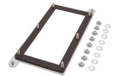
Push-through mounting frames for the Blocksize format
Push-through mounting frames for PM 240-2
Detailed description:
We recommend that an optional mounting frame is used to install the push-through device in a control cabinet. This mounting frame includes the necessary seals and frame to ensure compliance with degree of protection IP54.
If the Power Module is installed without use of the optional mounting frame, the user is responsible for ensuring that the appropriate degree of protection is obtained.

Slide 25
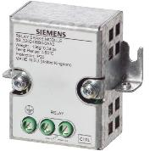
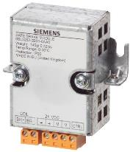
Brake Relay and Safe Brake Relay for the Blocksize format
The Brake Relay allows the motor brake to be directly controlled from the Control Unit
Detailed description:
The Brake Relay allows the Power Module to be connected to an electromechanical motor brake. The Brake Relay allows the motor brake to be driven directly by the Control Unit.
The Safe Brake Relay is controlled according to IEC 61508 SIL 2 and EN ISO 13849-1 PL d and Category 3

Slide 26
Table of contents
1
Introduction
2
Single-axis drives AC/AC
3
Multi-axis drives DC/AC
4
SINAMICS S120M distributed servo drive
5
SIMOTICS motors & DRIVE-CLiQ
6
Communication
7
Safety Integrated
8
Firmware functionality
9
Engineering tools
10
Digitalization
11
Support

Slide 27
SINAMICS S120 multi-axis drives System components
Control Unit
Line Modules AC/DC (power unit/infeed unit)
Motor Modules DC/AC (power unit)
Options
CU320-2
Basic technological functions.
Standard functions
Optional: BOP20
SIMOTION D
Motion control functions
PLC functionality
SINUMERIK PPU/NCU
Panel Processing Unit and numerical control functionality
PLC functionality
Basic Line Modules (BLM)
For infeed operation
Energy recovery not possible
Line reactor is required
Smart Line Modules (SLM)
For infeed and regenerative feedback operation
Line reactor is required
Active Line Modules (ALM)
For infeed and regenerative feedback with a controlled DC link voltage
ALM requires an Active Interface Module for operation
Line-side components To limit line harmonics => line reactors, line filters, Active Interface Modules
Components on the motor side
To limit voltage peaks in the motor windings
Components that can be supplied
to maintain and discharge the DC link
Supplementary system components
DRIVE-CLiQ Hub Modules
Terminal Modules
Voltage Sensing Modules
Encoder system connection
SMC and SME devices
Single Motor Modules
Connecting a motor
Double Motor Modules
Connecting two motors
Motor Modules Chassis
Connecting a motors
Distributed servo drive S120M (DC/AC)
Adapter Module AM600 (adapter)
+
Drive unit
Synchronous servomotor with integrated power unit and encoder
Reactors and filters

Slide 28
SINAMICS S120 Overview matrix – multi-axis drives
 | Control Unit |  |  | Line Modules AC/DC (power unit/infeed unit) |  |  | Motor Modules DC/AC (Power unit) |  | Special distributed servo converters (DC/AC) S120M
Format | CU320-2 | SIMOTION D | SINUMERIK PPU/NCU* | Basic Line | Smart Line | Active Line | Single | Double
Booksize Compact 3AC 380 - 480V | X | X | - | - | 16kW | - | 1.5 ... 9.7kW | 2x 0.9 ... 2.7 kW | 0.25 … 3.0 kW
Booksize 3AC 380 - 480V | X | X | X | 20 ... 100 kW | 5 ... 55kW | 16 ... 120kW | 1.5 ... 107kW | 2x 1.5 ... 9.7 kW | 0.25 … 3.0 kW
Chassis air cooled | X | X | X | 200…5500 kW | 250…5180 kW | 132…5320 kW | 110…4560 kW | - | -
Liquid cooled Chassis devices | X | X | - | 360…5070 kW | - | 380…6460 kW | 90…5700 kW | - | -
Chassis water cooled | X | X | - | - | - | 630…6460 kW | 90…5700 kW | - | -
*NCU: Numerical Control Unit / *PPU: Panel Processing Unit

Slide 29
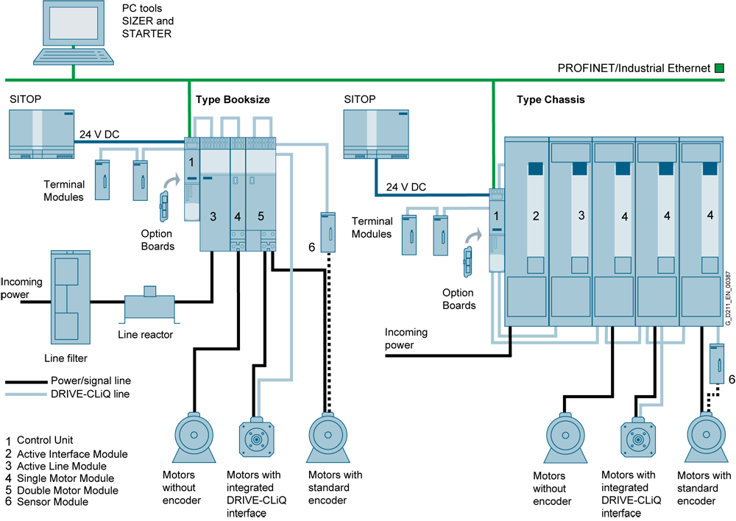
Machine configuration for multi-axis applications Example

Slide 30
Control Units
www.siemens.com/sinamics-s120
Unrestricted © Siemens 2021

Slide 31
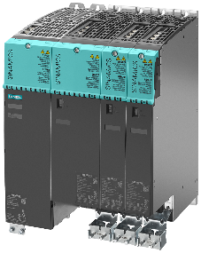



SINAMICS S120 Modular Control Units for every application
Various Control Units for fast adaptation to your specific application
Motion control
Drive control
Numerical Control
SIMOTION D
Functions of the CU320-2 PLUS
Motion control functions
PLC functionality
SINAMICS CU320-2
Basic technological functions.
Many standard and advanced functions
SINUMERIK sl NCU
Functions of the CU320-2 (without DCC and basic positioner) PLUS
Numerical Control functionality
PLC functionality
SINAMICS
CU320-2
SIMOTION D4xx-2
Line Modules
Motor Modules
Line Modules
Motor Modules
SINUMERIK
NCU 7xx.x
Line Modules
Motor Modules
Notes:
31

Slide 32
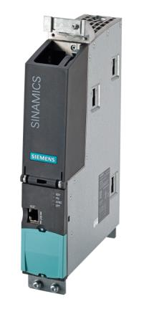
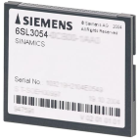
CU320-2 Control Units
CU320-2 Control Unit + SINAMICS S120 for positioning tasks and closed-loop speed control
Detailed description:
The communication, open-loop and closed-loop control functions for one or several Motor Modules and the Line Module are executed in a CU320-2.
For the closed-loop control of multi-axis drives
12x drives in V/f control – or 6x drives in servo or vector control possible
CU320-2 PN with integrated PROFINET interface or CU320-2 DP with PROFIBUS DP connection are available.
The CU utilization level can be determined in SIZER.
CompactFlash card for CU320‑2 Control Units:
The CompactFlash card contains the firmware, the set parameters and the license key.

Slide 33
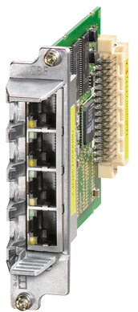
CBE20 Communication Board
Can be used to connect to a PROFINET IO network via a CU320-2 Control Unit
Detailed description:
The CBE20 is required, if
A SINAMICS S120 converter with a CU320-2 DP is to be connected to a PROFINET-IO network.
The SINAMICS Link for directly exchanging data between several CU320-2 DP or CU320-2 PN is to be used without a higher-level control system.
EtherNet/IP should be supported.

Slide 34
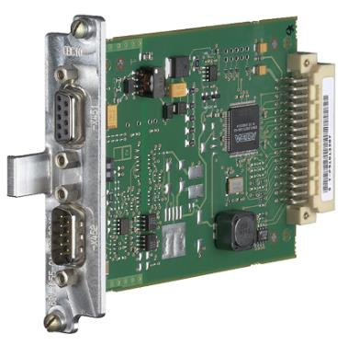
CBC10 Communication Board
The CBC10 allows the CU320‑2 Control Unit to interfaced with the CAN protocol
Detailed description
The CBC10 is used to interface the CU320-2 – and therefore the drive system – to the CAN protocol (Controller Area Network). The associated driver software complies with the standards of the following CANopen specification of the CiA (CAN in Automation)
Communication profiles in accordance with DS 301
Drive profile in accordance with DSP 402 (Profile Velocity Mode)
EDS (Electronic Data Sheet) in accordance with DSP 306
Signals the operating state according to DSP 305
It is installed in the CU320-2 option slot.

Slide 35
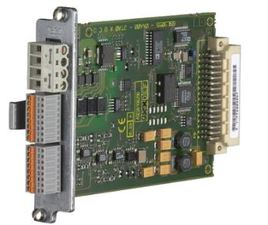
Terminal Board TB30
TB30 can be used to increase the number of terminals
Detailed description:
A Control Unit can be expanded by digital inputs/outputs as well as analog inputs/outputs.
The TB30 is inserted in the slot to optionally expand the CU320-2 Control Unit.
The following are provided on the TB30:
Power supply for digital inputs/digital outputs
4 digital inputs
4 digital outputs
2 analog inputs
2 analog outputs

Slide 36
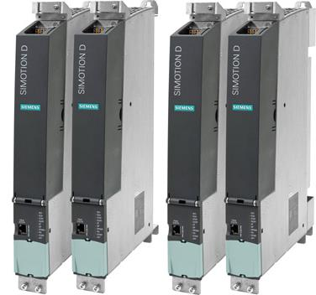
SIMOTION D4x5-2
SIMOTION D4x5-2 + SINAMICS S120 for demanding motion control tasks directly in the drive
Detailed description:
SIMOTION D4x5-2 are Control Units for multi-axis applications in the SINAMICS S120 in the Booksize format – and are available in the following performance versions:
SIMOTION D425-2 DP and D425-2 DP/PN Control Units (BASIC Performance) for up to 16 axes
SIMOTION D435-2 DP and D435-2 DP/PN Control Units (STANDARD Performance) for up to 32 axes
SIMOTION D445-2 DP/PN Control Units (HIGH Performance) for up to 64 axes
SIMOTION D455-2 DP/PN Control Units (ULTRA-HIGH Performance) for up to 128 axes
PLC, motion control and technology functions are directly integrated in the drive
Extremely simple engineering from the drive commissioning up to open-loop control and motion control applications.
Service friendly as a CompactFlash card can be simply replaced with all of the data (programs, data, drive parameters, license key).

Slide 37
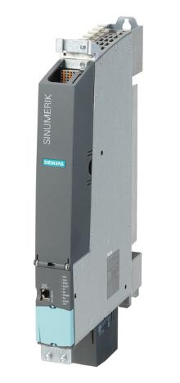
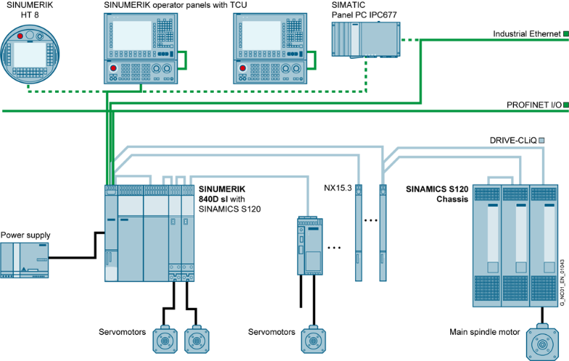
Control Unit: SINUMERIK 840D sl NCU 7x0.3B for Machine tool construction applications
SINUMERIK + SINAMICS S120 for the premium class of CNCs
Detailed description:
Highest performance in the premium class of CNC systems
Maximum degree of openness and flexibility
Drive-based, modular CNC
Multi-technology CNC
Modular panel concept up to 24” color display
Up to 30x machining channels
Up to 93x axes/spindles and any number of axes controlled by the PLC
SINUMERIK 840D sl
NCU 730.3B PN

Slide 38
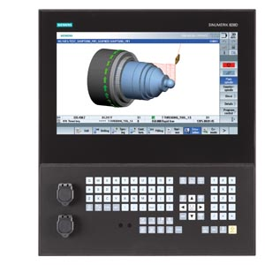
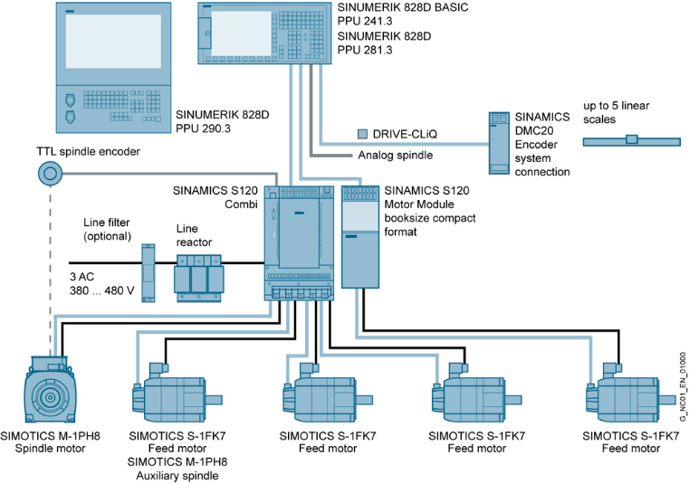
Control Unit: SINUMERIK 828 PPU 2x0.3 for Machine tool construction applications
SINUMERIK + SINAMICS S120 for the compact class of CNC systems
Detailed description:
Solutions in the compact class for cost-sensitive markets
High CNC performance
Simple commissioning
Up to 10x axes/spindles and 2x auxiliary axes
Up to 2x machining channels
10.4"-/15.6" color display
SINUMERIK 828 Advanced PPU 290.3

Slide 39
Line Modules Booksize and Booksize Compact formats
www.siemens.com/sinamics-s120
Unrestricted © Siemens 2021

Slide 40
Line Modules Various principles for an efficient solution
Line Modules generate a DC voltage from the line voltage. They supply the Motor Modules with power via the DC link.
Active Infeed
Active Interface Modules (AIM)
Active Line Module (ALM)
For infeed and regenerative feedback with a controlled DC link voltage
ALM requires an Active Interface Module for operation
=
Line Modules (power unit/infeed unit)
AC→DC
Smart Infeed
=
Smart Line Module (SLM)
Line connection with reactor
For infeed and regenerative feedback operation
Line reactor is required
Basic Infeed
Basic Line Module (BLM)
Line connection with reactor
Suitable for infeed operation
Energy recovery not possible
Line reactor is required
=

Slide 41
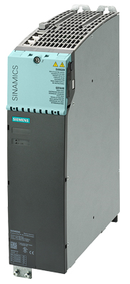
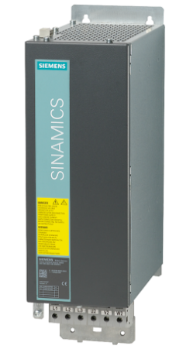
Active Line Modules/Active Interface Modules Booksize format
High-end infeed unit
Detailed description:
Active Line Modules can supply energy and return regenerative energy to the line supply.
The ALM provides a constant and controlled DC link voltage for the drive line up
The associated Active Interface Module is required when operating an Active Line Module – both of these modules form a functional unit.
The AIM has a Clean Power Filter and basic interference suppression. For the ALM, they provide the required line-side components – for example, commutating reactor, line filter and switching frequency filter.
Compliance with Category C3 regarding noise emission, an additional Basic Line Filter is required to achieve Category C2.
ALM
AIM Example 36kW

Slide 42
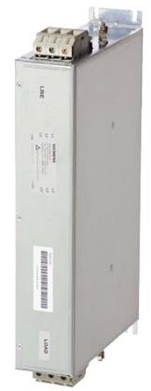
Active Line Modules Basic Line Filter
Basic Line Filters reduce line disturbances and stress levels
Detailed description:
Basic Line Filters can be optionally used in addition to the Active Interface Modules if more stringent EMC requirements must be complied with.
Basic Line Filter + AIM:
Expansion of the limit values for interference voltages to Category C2 (EN 61800-3)
Longer total cable lengths possible, but still complying with Category C3
Basic Line Filters are used if cable-conducted interference in the frequency range 150 kHz to 30 MHz have to be damped in accordance with the requirements of the applicable CE-EMC legislation.

Slide 43
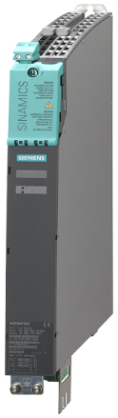

Smart Line Modules Booksize and Booksize Compact formats
Uncontrolled infeed and regenerative feedback unit
Detailed description:
Smart Line Modules are uncontrolled infeed/regenerative feedback units that supply power to connected Motor Modules.
Furthermore, they are capable of feeding regenerative energy back into the grid.
The infeed is realized using a diode bridge, while line-commutated regenerative feedback (commutation fault-proof) is realized using IGBTs with 100% continuous feedback rating.
The regenerative capability of the modules can be deactivated by appropriately parameterizing them.
Smart Line Modules can be connected to grounded TN/TT and ungrounded IT supply systems.
The associated line reactor is required when operating the Smart Line Module.
Smart Line Modules are available for the power range from 5 kW to 55 kW
SLM Booksize Compact format are only available as 16 kW version
380
270
226
270
Booksize Compact and Booksize differ regarding depth and height

Slide 44
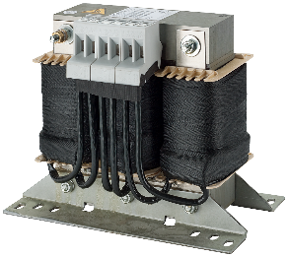
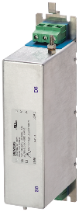
Smart Line Modules Line reactors and line filters
Line reactors and line filters reduce line disturbances and loads
Feature
Line reactors limit low-frequency harmonics that are fed back into the line supply.
Dampen commutation dips.
Line reactors are essential for the correct functioning of the Smart Line Modules.
Line filters at the converter input filter harmonics and/or voltage disturbances that are generated in the converter.
In combination with line reactors and a systematic plant configuration, line filters limit the interference emitted by the Power Modules to the limit values of Category C2 according to IEC 61800‑3.

Slide 45
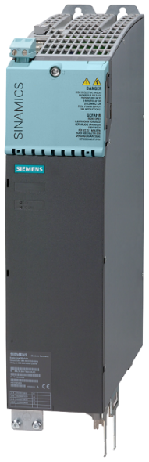
Basic Line Modules
Uncontrolled infeed unit
Detailed description:
For applications where there is no regenerative energy – or the energy is exchanged between motoring and generating axes in the DC link.
BLMs can feed power back from the line supply into the DC link – they cannot feed power back into the line supply.
Basic Line Modules can be connected to grounded TN/TT and ungrounded IT supply systems.
20 kW and 40 kW Basic Line Modules with integrated braking chopper in conjunction with an external braking resistor can be used when operating in the generating mode.
In addition to an external braking resistor, the BLM 100 kW requires a Braking Module when operating in the generating mode.

Slide 46
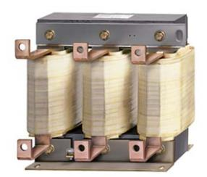
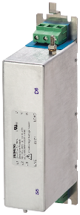
Basic Line Modules Line reactors and line filters
Line reactors and line filters reduce line disturbances and loads
Detailed description:
Line reactors limit low-frequency harmonics that are fed back into the line supply
Dampen commutation dips
Line reactors reduce the stress on the power semiconductors in the Basic Line Module
Line filters at the converter input filter harmonics and/or voltage disturbances that are generated in the converter.
In combination with line reactors and a systematic plant configuration, line filters limit the interference emitted by the Power Modules to the limit values of Category C2 according to IEC 61800‑3, depending on the sum of the cable lengths (motor feeder cables and DC link cables).
The notes and instructions provided in the “EMC Installation Guidelines Configuration Manual” must be strictly complied with.

Slide 47


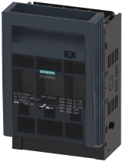
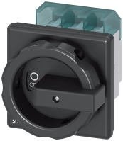
Active Line, Smart Line and Basic Line Modules Recommended line-side components
Suitable line-side power components are assigned depending on the power rating, e.g.:
Isolated load disconnector
LV HRC fuses
Load disconnector with fuse
Main and EMERGENCY OFF switch
Note: Additional information about the line-side power components can be found in Catalogs LV 10, IC 10 and IC 10 AO as well as the Industry Mall.

Slide 48
Line Modules Chassis format
www.siemens.com/sinamics-s120
Unrestricted © Siemens 2021

Slide 49
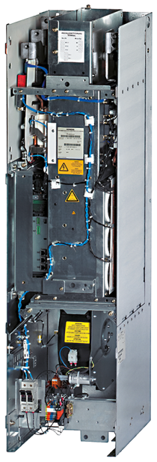
Basic Line Modules Chassis format – air cooled
Uncontrolled infeed unit
Detailed description:
For applications where there is no regenerative energy – or the energy is exchanged between motoring and generating axes in the DC link.
BLMs can feed power back from the line supply into the DC link – they cannot feed power back into the line supply.
Basic Line Modules can be connected to grounded TN/TT and ungrounded IT supply systems.
In addition to an external braking resistor, the Basic Line Module requires a Braking Module for regenerative operation.
Basic Line Modules, frame size GD for 900 kW (400 V) or 1500 kW (690 V) include a diode bridge – the DC link is precharged via a separate line-side precharging circuit.

Slide 50
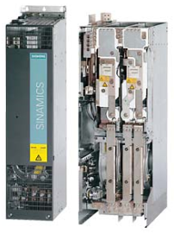
Smart Line Modules Chassis format – air cooled
Uncontrolled infeed and regenerative feedback unit
Detailed description:
Smart Line Modules are uncontrolled infeed/regenerative feedback units that supply power to connected Motor Modules.
Furthermore, they are capable of feeding regenerative energy back into the grid.
The infeed is realized using a diode bridge, while line-commutated regenerative feedback (commutation fault-proof) is realized using IGBTs with 100 % continuous feedback rating.
The regenerative capability of the modules can be deactivated by appropriately parameterizing them.
Smart Line Modules can be connected to grounded TN/TT and ungrounded IT supply systems.
The DC link is precharged using integrated precharging resistors.
To operate the Smart Line Module, the associated line reactor or a suitable transformer is required.

Slide 51
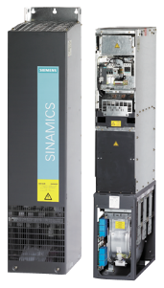
Active Line Modules/Active Interface Modules Chassis format – air cooled
ALM and AIM form a functional unit
Detailed description:
Active Line Modules can supply energy and return regenerative energy to the line supply.
The ALM provides a constant and controlled DC link voltage for the drive line up.
The associated Active Interface Module is required when operating an Active Line Module – both of these modules form a functional unit.
The AIM has a Clean Power Filter and basic interference suppression, a precharging circuit for the ALM, line voltage sensing, monitoring sensors as well as bypass contactor (optional for frame sizes HI and JI)
Complies with Category C3 regarding interference emission, an additional filter is required to comply with Category C2.
ALM
AIM

Slide 52
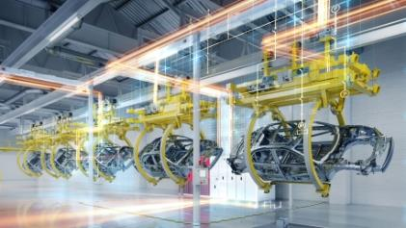


Chassis format – liquid cooled
Highest power density through efficient cooling
Detailed description:
Liquid cooling
The power semiconductors are mounted on the heat sink, through which the cooling medium flows. The power loss of the device is dissipated to the cooling medium and
in turn, dissipated outside the control cabinet.
High power density
Footprint-optimized format
Heat is far more efficiently dissipated than for air-cooled devices
Quiet devices, only a small fan is required
For Unrestricted space and/or harsh ambient conditions
Example of a drive system with SINAMICS S120 liquid cooled

Slide 53



Chassis format – water cooled
Characterized by the low requirements placed on the cooling water quality
Detailed description:
Water cooling
The devices are designed for operation in a commoncooling circuit for the plant/system, motor and converter. The water in the cooling
circuit requires, when compared to
liquid-cooled SINAMICS S120 Chassis
devices, a significantly reduced water
quality.
High power density
Utilization of the power loss as process heat
Quiet devices, only a small fan is required
For Unrestricted space and/or harsh ambient conditions
Example of a drive system with SINAMICS S120 water cooled

Slide 54

Basic Line Modules Chassis format – liquid cooled
Uncontrolled infeed unit
Detailed description:
Basic Line Modules are suitable for applications where no regenerative energy occurs – or if energy is exchanged between motoring and generating axes in the DC link.
The module provides the Motor Modules with the DC link voltage.
The power rating can be increased by connecting up to four Basic Line Modules with the same power rating in parallel.
Available power ratings:
3AC 380 – 480V: 360 - 830kW /3070*kW
3AC 500 – 690V: 355 - 1370kW / 5070*kW
*Four devices connected in parallel and 7.5% derating

Slide 55


Active Line Modules/Active Interface Modules Chassis format – water and liquid cooled
ALM and AIM form a functional unit
Detailed description:
Active Line Modules can supply energy and return regenerative energy to the line supply.
The ALM provides a constant and controlled DC link voltage for the drive line up.
The associated Active Interface Module is required when operating an Active Line Module – both of these modules form a functional unit.
The AIM has a Clean Power Filter and a basic noise suppression function, a precharging circuit for the ALM, line voltage sensing, monitoring sensors as well as a bypass contactor (optional for frame sizes HI and JI)
Complies with Category C3 regarding interference emission, an additional filter is required to comply with Category C2.
ALM liquid
cooled
ALM water
cooled

Slide 56
Motor Modules Booksize and Booksize Compact formats
www.siemens.com/sinamics-s120
Unrestricted © Siemens 2021

Slide 57



Motor Module portfolio 3A - 200A (400V) Booksize format
SMM D type | 3A/9A 50mm | 5A/15A 50mm | 9A/27A 50mm | 18A/54A 50mm | 24A/72A 50mm | 30A/90A 100mm
DMM D type | 2x3A/9A 50mm | 2x5A/15A 50mm | 2x9A/27A 50mm | 2x18A/54A 100mm
SMM C type |  |  |  | 18A/36A 50mm | 24A/48A 50mm | 30A/56A 100mm | 45A/90A 100mm | 60A/120A 100mm
DMM C type |  |  |  | 2x18A/36A 100mm
SMM |  |  |  |  |  |  |  |  | 85/141A 200mm | 132/210A 300mm | 200/282A 300mm
SMM: Single Motor Module; DMM Double Motor Module
Features
C type Continuous motion:
Double overload, optimized for continuous load cycles
typical for main spindle drives and continuous load cycles
NEW! manufactured according to environmental class/harmful chemical substances 3C3 ¹⁾ and G3 ²⁾
D type: Discontinuous motion:
300% overload, optimized for highly dynamic, intermittent load cycles
typical for feed and positioning drives
New! manufactured according to environmental class/harmful chemical substances 3C3 ¹⁾ and G3 ²
Motor Modules C-/D-Type 3A-60A Height: 380mm; Depth: 270mm
coating standard EN 60721-3-3
coating standard d ISA-71.04

Slide 58
SIPLUS extreme
 |  | EN 60721-3-3 | ISA-71.04 | EN 60721-3-3 | ISA-71.04 | EN 60721-3-3 | ISA-71.04 | EN 60721-3-3 | ISA-71.04
 |  | 3C1 ²⁾ | G1 | 3C2 | G2 | 3C3 | G3 | 3C4 | GX ⁴⁾
Gas
H₂S | Group A | < 7,1 | < 3 | < 360 ¹⁾ | - ³⁾ | < 7 100 | - ³⁾ | < 49 700 | - ³⁾
 |  |  |  | < 71 ²⁾ | < 10 | < 2 100 | < 50 | < 9 900 | >= 50 ⁴⁾
SO₂, SO₃ |  | < 37 | < 10 | < 370 | - ³⁾ | < 3 700 | - ³⁾ | < 14 800 | - ³⁾
 |  |  |  | < 110 | < 100 | < 1 850 | < 300 | < 4 800 | >= 300 ⁴⁾
Cl₂ |  | < 34 | < 1 | < 100 | - ³⁾ | < 340 | - ³⁾ | < 1 000 | - ³⁾
 |  |  |  | < 34 | < 2 | < 100 | < 10 | < 200 | >= 10 ⁴⁾
NO_{x} |  | < 52 | < 50 | < 520 | - ³⁾ | < 4 680 | - ³⁾ | < 10 400 | - ³⁾
 |  |  |  | < 260 | < 125 | < 1 560 | < 1 250 | < 5 200 | >= 1 250 ⁴⁾
HF | Group B | < 3,6 | < 1 | < 36 | - ³⁾ | < 2 400 | - ³⁾ | < 2 400 | - ³⁾
 |  |  |  | < 12 | < 2 | < 120 | < 10 | < 120 | >= 10 ⁴⁾
NH₃ |  | < 420 | < 1 500 | < 4 200 | - ³⁾ | < 49 000 | - ³⁾ | < 247 000 | - ³⁾
 |  |  |  | < 1 400 | < 10 000 | <14 000 | < 25 000 | < 49 000 | >= 25 000 ⁴⁾
O₃ |  | < 5 | < 2 | < 50 | - ³⁾ | < 150 | - ³⁾ | < 1 000 | - ³⁾
 |  |  |  | < 25 | < 25 | < 50 | < 100 | < 100 | >= 100 ⁴⁾
HCl |  | < 66 | - ⁵⁾ | < 330 | - ⁵⁾ | < 3 300 | - ⁵⁾ | < 3 300 | - ⁵⁾
 |  |  |  | < 66 | - ⁵⁾ | < 660 | - ⁵⁾ | < 660 | - ⁵⁾
All values in the table above are already standardized on the unit ,parts per billion’ (10⁹); rH <75%.
EN 60721-3-3: class 3C1 – 3C4, normative unit ‚parts pro million‘ (10⁶)
1) Limiting value for max. 30 minutes per day
2) Mean average value
ISA-71.04: severity level G1 – GX, normative unit ‘parts per billion‘ (10⁹)
3) no limiting values defined (comparable 30 min per day)
4) ISA-71.04 has not upper limit for severity level GX, this must be negotiated between product manufacturer and user
5) HCl is not part of the ISA-71.04

Slide 59


Motor Modules C/D type in the Booksize format Single Motor Modules
Motor Module: The DC-AC inverter in the drive lineup (power unit)
Detailed description:
The Motor Module has an integrated voltage DC link and an inverter to supply a motor.
Motor Modules provide the power for the motor – they draw their power from the DC link of the drive lineup.
A Motor Module must be connected to a Control Unit via DRIVE-CLiQ. The open-loop and closed-loop control functions for the Motor Module are located in the CU.
Rated output currents from 3 A to 60 A.
C/D types are innovative devices with 200% or 300% overload (continuous/discontinuous motion).
NEW! manufactured according to environmental class/harmful chemical substances 3C3 ¹⁾ and G3 ²
3A-24A unit Width: 50mm
coating standard EN 60721-3-3
coating standard d ISA-71.04
60A unit Width: 100mm

Slide 60

Motor Modules C/D type in the Booksize format Double Motor Modules
Motor Module: The DC-AC inverter in the drive lineup (power unit)
Detailed description:
Motor Modules provide the power for the motor – they draw their power from the DC link of the drive lineup.
A Motor Module must be connected to a Control Unit via DRIVE-CLiQ. The open-loop and closed-loop control functions for the Motor Module are located in the CU.
Rated output currents of 2 x 3 A to 2 x 18 A
C/D types are innovative devices with 200% or 300% overload (continuous/discontinuous motion).
NEW! manufactured according to environmental class/harmful chemical substances 3C3 ¹⁾ and G3 ²
2x 18A unit, Width:100mm
coating standard EN 60721-3-3
coating standard d ISA-71.04

Slide 61

Motor Modules 85A – 200A in the Booksize format Single Motor Modules
Motor Module: The DC-AC inverter in the drive lineup (power unit)
Detailed description:
Up until now, frame sizes 85A, 132A and 200A have not been switched over to the C/D type!
Motor Modules provide the power for the motor – they draw their power from the DC link of the drive lineup
A Motor Module must be connected to a Control Unit via DRIVE-CLiQ. The open-loop and closed-loop control functions for the Motor Module are located in the CU.
The shield connecting plate is optionally available.
132A / 200A unit, Width: 300mm

Slide 62
Motor Modules Booksize Compact format
Motor Module: The DC-AC inverter in the drive lineup (power unit)
Detailed description:
The Booksize Compact format combines the advantages of the Booksize format with the same performance and lower height and depth.
Designed for applications demanding a high dynamic performance.
Motor Modules provide the power for the motor – they draw their power from the DC link of the drive lineup.
SMM |  | 3A/9A 50mm | 5A/15A 50mm | 9A/27A 50mm | 18A/54A 75mm
DMM | 2x1.7A/5.1A 75mm | 2x3A/9A 75mm | 2x5A/15A 75mm
270
380
226
270
Booksize Compact
Booksize

Slide 63
Motor Modules Chassis format – air cooled
www.siemens.com/sinamics-s120
Unrestricted © Siemens 2021

Slide 64
Motor Modules Chassis format – air cooled
Motor Module: The DC-AC inverter in the drive lineup (power unit)
Detailed description:
The Motor Module generates a variable voltage with variable frequency from the DC link voltage that feeds the connected motor.
Several Motor Modules can be operated on a common DC link. This means that energy can be exchanged between the various Motor Modules. For example, if a Motor Module regenerates, then the other Motor Modules that are motoring can utilize this energy.

Slide 65

Motor Modules – The new device series SINAMICS S120 Chassis-2 format – air cooled
Chassis-2 – mechanical innovations (available for 500kW, 560kW and 630kW)
Features/functions |  | Benefits
Stable, stand-alone design The new Chassis devices are equipped with rollers and can stand alone. | ◆ | Simple integration into control cabinets New applications can be addressed
Standardized dimensions All of the Chassis devices have the same dimensions from 315 kW to 800 kW | ◆ | Lower engineering costs Fewer parts are required for integration in a cabinet
Improved cooling system Enclosed air ducts and enclosed housing | ◆ | Lower cooling costs Lower risk of damage Higher reliability
Standardized terminals All control and power connections are located at the same position | ◆ | Lower engineering costs Faster diagnostics & troubleshooting Lower installation costs
Lower dimensions Dimensions corresponding to state-of-the-art technology | ◆ | Lower space requirement SINAMICS and MASTERDRIVES can be retrofitted
Chassis-2 air cooled

Slide 66
Motor Modules – The new device series SINAMICS S120 Chassis-2 format – air cooled
Chassis-2 – electronic innovations (available for 500kW, 560kW and 630kW)
Feature / function |  | Benefits
Higher output frequency Standard pulse frequency 2.5 kHz | ◆ | High speed applications can be addressed Most applications can be operated without pulse frequency derating
Less motor noise Lower clock frequency noise | ◆ | Quieter
Minimized derating at low frequencies | ◆ | Low-speed applications can be addressed at a more favorable cost
Higher load cycling capability Simplified characteristic | ◆ | Applications demanding a high dynamic response can be addressed at a more favorable cost
Output options without power derating | ◆ | Applications involving additional requirements – such as dv/dt restrictions – can be implemented at a favorable cost
Chassis-2 air cooled

Slide 67
Motor Modules Chassis format – liquid cooled
Motor Module: The DC-AC inverter in the drive lineup (power unit)
Detailed description:
The Motor Module generates a variable voltage with variable frequency from the DC link voltage that feeds the connected motor.
Several Motor Modules can be operated on a common DC link. This means that energy can be exchanged between the various Motor Modules. For example, if a Motor Module regenerates, then the other Motor Modules that are motoring can utilize this energy.
Available power ratings:
3AC 380 – 480V: 110 – 800kW /3040*kW
3AC 500 – 690V: 90 – 1500kW /5700*kW
*Four devices connected in parallel and 5% derating

Slide 68
DC link components Booksize format
www.siemens.com/sinamics-s120
Unrestricted © Siemens 2021

Slide 69



Braking Module braking resistor for Booksize and Booksize Compact formats
Braking unit facilitates occasional braking for infeed units that are not capable of energy recovery
Detailed description:
In conjunction with an external braking resistor, the Braking Module forms a braking unit.
It is frequently used for the ESR function (SINUMERIK "Extended stopping and retraction")
For brief generator operation, the Braking Module can limit the DC link voltage.
In operation, the DC link energy is converted into heat in the external braking resistor.
Locating the braking resistor outside the cabinet means that power losses can be dissipated. Climate control costs are reduced.

Slide 70

Capacitor Module for Booksize formats
Brief power failures can be buffered
Detailed description:
The Capacitor Module is used to increase the DC link capacitance to buffer brief power failures.
It is connected to the DC link voltage via the integrated DC link buses. The Capacitor Module operates independently.
Several Capacitor Modules can be connected in parallel. The limit for precharging the Line Module is 20mF as standard.

Slide 71


Control Supply Module for Booksize formats
24 V DC power supply
Detailed description:
The Control Supply Module Booksize format provides an adjustable power supply from 24 V up to 28.8 V DC via the line supply or the DC link.
The device can be operated alone or in parallel with a maximum of 10 devices. In a no-current state, a DIP switch is used to switch over between single and parallel operation. The use of a SITOP redundancy module is recommended for parallel connections.
For example, using the Control Supply Module it is possible to retract axes in an emergency when the power fails as long as the DC link voltage is available.
CSM
SITOP PSE

Slide 72
DC link rectifier adapter for Booksize and Booksize Compact formats
SINAMICS DC link rectifier adapter for device widths from 50mm bis 300mm
Detailed description:
If the internal DC link busbars of the Motor Modules cannot be used, then the DC link voltage must be fed in from outside using a DC link rectifier adapter. This is mounted on the DC link busbars of the Motor Module. The DC link cables are fed in from the top.
DC link rectifier adapter for device widths 50mm and 100m 6SL3162-2BD00-0AA0
DC link rectifier adapter for device widths 150mm to 300m
SL3162-2BM00-0AA0
DC link rectifier adapter for device widths 100 mm
6SL3162-2BE00-0AA0
NEW!

Slide 73
DC link rectifier adapter for direct infeed of DC link voltage
Articlenumber | suitable for Line-/Motor Modules Booksize format in width | max. connectable cross-section | max. current rating
6SL3162-2BD00-0AA0 | 50 mm, 100 mm | 10 mm² | 43 A
6SL3162-2BM00-0AA0 | 150 mm, 200 mm, 300 mm | 95 mm² | 240 A
6SL3162-2BE00-0AA0 | 100 mm | 12 mm² | 72 A
NEW!

Slide 74

SINAMICS S120 Booksize DC link rectifier adapter for modules with a width of 100 mm
NEW!
Description
Especially developed for SINAMICS S120 Booksize 45/60A C/D-Type Motor Modules with a width of 100 mm
Current carrying capacity 72 A
An optimized cable outlet direction allows a highly compact design
SINAMICS S120 DC Link Adapter is released for the following Motor Modules: 6SL3120-1xE24-5ACx (45 A) 6SL3120-1xE26-0ACx (60A) 6SL3120-2xE21-8ADx (2x18 A) 6SL3120-2xE21-8ACx (2x18A) 6SL3120-1xE23-0ADx (30 A) 6SL3120-1xE23-0ACx (30A)
6SL3162-2BE00-0AA0

Slide 75

Motor reactors for the Booksize format
Motor reactors reduce the voltage stress on the motor windings
Detailed description:
At the same time, capacitive recharging currents are also reduced, which additionally load the power unit when long motor cables are being used.
The maximum permissible output frequency when using a motor reactor is 120 Hz.
The motor reactors are designed for a pulse frequency of 4 kHz. Higher pulse frequencies are not permissible.
The motor reactor must be installed as close as possible to the Motor Module.

Slide 76

Voltage Protection Module
VPM to protect the converter
Detailed description:
The VPM is used for permanent-magnet synchronous motors with a high EMF (electromagnetic force) in order to limit the DC link converter voltage if a short-circuit occurs at the motor terminals.
The precondition is that permanent-magnet synchronous motors are operated in the field-weakening mode far above the rated speed of conventional motors. The maximum permissible DC link voltage can be exceeded in the case of a fault, i.e. the closed-loop motor control is shutdown, power failure, "Emergency Off", interrupted cable etc.
By inserting the VPM between the SINAMICS Booksize device and motor, high voltage levels are identified and short-circuited - therefore preventing the converter system from being destroyed.

Slide 77
Supplementary system components
www.siemens.com/sinamics-s120
Unrestricted © Siemens 2021

Slide 78






Terminal Modules Supplementary system components
Extended possibilities using Terminal Modules
Detailed description:
TM15: Expansion of the number of existing digital inputs/outputs in the drive system.
TM31: Expansion of the number of existing digital inputs/outputs and analog inputs/outputs in the drive system.
TM41: Supplies TTL signals as incremental encoder emulation – e.g. to a higher-level control system – and expands the number of existing digital inputs/outputs and analog inputs/outputs in the drive system.
TM54F: Facilitates the use of Safety Integrated functions in the SINAMICS drive system via external actuators and sensors.
TM120: Four temperature sensors can be evaluated (KTY84‑130 or PTC). Suitable for evaluating the temperature of special motors, e.g. linear motors 1FN and built-in 1FW6 torque motors.
TM150: DRIVE-CLiQ components for temperature evaluation.
NEW! manufactured according to environmental class/harmful chemical substances 3C3 ¹⁾ and G3 ²
TM15
TM31
TM41
TM54F
TM120
TM150
coating standard EN 60721-3-3
coating standard d ISA-71.04

Slide 79

VSM10 Voltage Sensing Module
Module to sense the line voltage
Detailed description
Voltage Sensing Module that is used to sense the actual value for Active Line Modules and Smart Line Modules (16 kW and 36kW). The three line supply voltage phases are sensed upstream of the line reactor and made available to the respective Line Modules.
Options for the Booksize and Chassis format
Standard for format Chassis Active Interface Modules and Smart Line Modules
Communication via DRIVE-CLiQ possible

Slide 80


Sensor Module Cabinet-Mounted (SMC)
Modules to evaluate encoder signals from motors without DRIVE-CLiQ interface
Detailed description
SMC modules are designed for installation in control cabinets (degree of protection IP20).
Sensor Module Cabinet-Mounted SMC10 for:
Resolvers (2 and multi-pole)
Encoder connection including motor temperature sensing (KTY 84-130, Pt1000 or PTC)
Maximum encoder cable length, 130 m (2-pole resolver) or 50 m (multi-pole resolver)
Sensor Module Cabinet-Mounted SMC20 for:
Incremental encoders with sin/cos 1 Vpp, absolute encoders EnDat 2.1, SSI encoders with incremental signals sin/cos 1 Vpp
Encoder connection including motor temperature sensing (KTY 84-130, Pt1000 or PTC)
Maximum encoder cable length, 100 m
Sensor Module Cabinet-Mounted SMC30 for:
TTL encoder / HTL encoder, SSI encoder with and without incremental signals TTL/HTL
Encoder connection including motor temperature sensor (KTY 84-130, Pt1000 or PTC)
Maximum encoder cable length, 100 m (for HTL encoders up to 300 m)
SMC10/SMC20
SMC30

Slide 81

Encoder system connection via SMC (Sensor Module Cabinet-Mounted)
Encoder cable
cable
Power cable
Control cabinet

Slide 82


Sensor Module External (SME)
Modules to evaluate encoder signals from motors without DRIVE-CLiQ interface
Detailed description
SME modules are designed for installation outside control cabinets (degree of protection IP67).
Sensor Modules External SME20/SME25 for:
Incremental encoders sin/cos 1 Vpp without rotor position track (C and D tracks), absolute encoders EnDat 2.1 and absolute encoders SSI with incremental signals sin/cos 1 Vpp
SME20: Motor temperature can be evaluated using KTY/ Pt1000/ PTC temperature sensors
Can be used for motors without absolute track signals (C and D tracks), e.g.:
Synchronous motors with pole position identification (SIMOTICS L-1FN/T-1FW/M-1FE)
Induction motors (SIMOTICS M-1PH)
Sensor Modules External SME120/SME125 for:
Incremental encoders sin/cos 1 Vpp, absolute encoders EnDat 2.1 and absolute encoders SSI with sin/cos 1 Vpp incremental signals (without reference signal)
Motor temperature can be evaluated using PTC thermistors KTY84-130, Pt1000 or PTC
Especially suitable for SIMOTICS linear motor and torque motor applications
SME20/SMC25
SMC120/SME125

Slide 83

Encoder system connection via SME (Sensor Module External)
Encoder cable
Control cabinet

Slide 84
Accessories Chassis format
www.siemens.com/sinamics-s120
Unrestricted © Siemens 2021

Slide 85

Mounting device for Powerblocks Chassis format – air cooled
Simple installation and removal of Powerblocks
Detailed description:
Powerblocks are an integral component of the power units, Chassis format. These are only available as spare part. Power units are Basic Line Modules, Smart Line Modules, Active Line Modules, Power Modules and Motor Modules
The mounting device is used for installing and removing the Powerblocks.
The complete power unit in the Chassis format cannot be removed with the mounting device.
Article No.: 6SL3766-1FA00-0AA0

Slide 86


Mounting device for power units Chassis-2 format air cooled
Simple installation and removal of power units in the Chassis-2 format
Possibilities
The power units of the Chassis-2 format are presently available as Motor Modules and Active Line Modules.
The complete Chassis-2 devices are removed or installed using the mounting device.
There are two options for lifting the devices (weighing approx. 160 kg) up to the necessary height.
Ramp (does not have to be screwed to the cabinet frame): For low heights
Lifting device (similar to a crane) – height can be flexibly adapted using a plate and standard tools.
The mechanical "crane" is also intended as service tool. It can be broken down into individual parts of less than 60 cm – and has a weight of approx. 12 kg.

Slide 87


Mounting device for power units Chassis format water and liquid cooled
Simple installation and removal of power units (PM160kW: 108kg)
Possibilities
The mounting device is used for installing and removing the water-cooled and liquid-cooled power units. Power units are Basic Line Modules, Smart Line Modules, Active Line Modules, Power Modules and Motor Modules.
The mounting device is only a mounting aid. Further, a lifting device is required, to place the power unit down onto the floor. An 800kW Motor Module weighs approximately 230kg.
The device is used to remove the complete Chassis format power unit.
The device weighs approx. 15 kg, can be folded-up and is easy to transport
Article No.: 6SL3766-1CA00-0AA0

Slide 88


SINAMICS S120 Chassis format Line reactors
Line reactors and line filters reduce line disturbances and loads
Detailed description:
A line reactor is required for high line short-circuit power levels (i.e. low line feeder cable inductance) in order to
protect the drive converter itself from excessively high harmonic currents and therefore overload
limit the harmonics to permissible values. The harmonic currents are limited by the total inductance comprising the line reactor and line supply cable inductance.
Line filters at the converter input filter harmonics and/or voltage disturbances that are generated in the converter. In combination with line reactors and a systematic plant configuration, they limit the interference emitted by the Power Modules to the limit values of Category C2 according to IEC 61800‑3.

Slide 89
Table of contents
1
Introduction
2
Single-axis drives AC/AC
3
Multi-axis drives DC/AC
4
SINAMICS S120M distributed servo drive
5
SIMOTICS motors & DRIVE-CLiQ
6
Communication
7
Safety Integrated
8
Firmware functionality
9
Engineering tools
10
Digitalization
11
Support

Slide 90
Distributed servo drive SINAMICS S120M
www.siemens.com/sinamics-s120
Unrestricted © Siemens 2021

Slide 91

System overview – SINAMICS S120 with distributed servo drive technology S120M
SINAMICS S120M is a member of the SINAMICS S120 drive family. The complete drive comprises the following :
Control Unit (SINAMICS / SIMOTION / SINUMERIK)
Centrally in the control cabinet
Line Modules AC/DC (infeed unit)
Adapter Modules 600 (AM600)
S120M DC/AC
SINAMICS S120M distributed comprises the following units:
1FK7 synchronous motor with integrated Power Module and encoder
Hybrid Cable (connection system)
DRIVE-CLiQ Extension (DQE)
Hybrid Cabinet Bushing (HCB)
Decentrally in the machine

Slide 92



System overview – SINAMICS S120 with distributed servo drive technology S120M
Line reactors and line filters reduce line disturbances and loads
Detailed description:
S120M is a synchronous motor with integrated power unit (DC/AC). New machine concepts can be addressed as a result of the distributed integration into machines. Advantages include less space required in the control cabinet, longer power cables and modular machine concept, for example.
Adapter Module 600 (AM600) is the interface between the central SINAMICS (Booksize) components and the S120M.
The AM600 feeds the DC link voltage, generated by a central infeed unit (Line Module), into the hybrid cable of the S120M.
The DC link voltage is distributed to the S120M devices connected in the drive lineup via the Hybrid Cable.
Hybrid Cable
AM600
S120M

Slide 93
Table of contents
1
Introduction
2
Single-axis drives AC/AC
3
Multi-axis drives DC/AC
4
SINAMICS S120M distributed servo drive
5
SIMOTICS motors & DRIVE-CLiQ
6
Communication
7
Safety Integrated
8
Firmware functionality
9
Engineering tools
10
Digitalization
11
Support

Slide 94
SIMOTICS motors & DRIVE-CLiQ
www.siemens.com/sinamics-s120
Unrestricted © Siemens 2021

Slide 95


SIMOTICS motors – the comprehensive range of motors for SINAMICS S120
SINAMICS S120 for SIMOTICS low-voltage motors and motion control applications
Detailed description:
SIMOTICS low-voltage motors as standard and trans-standard motors or explosion protected versions for almost all sectors
SIMOGEAR geared motors
SIMOTICS reluctance motors: the cost-effective choice for energy efficiency and dynamic performance – e.g. for winders, extruders and servo pumps
SIMOTICS S servomotors, optionally equipped with various gearbox types, for high-speed positioning tasks, clocked axes and feed drives
SIMOTICS M main motors for high speed, high precision rotary axes, e.g. for winding and synchronous operation applications – as well as main spindles in machine tools
SIMOTICS L linear motors for positioning and feed axes demanding the highest dynamic performance
SIMOTICS T torque motors, which are directly mounted to the driven machine component demanding the highest dynamic performance

Slide 96



SINAMICS S120 DRIVE-CLiQ
DRIVE-CLiQ – the innovative system interface between S120 components
Detailed description:
This innovative high-performance interface allows converter components to be simply linked with one another from a data perspective – and also allows motors and direct rotary and linear encoder systems to be integrated in the drive system.
DRIVE-CLiQ is an open interface and facilitates connecting encoders and measuring systems from any manufacturer.
Automatic configuration with an electronic rating plate
Fast diagnostics in the case of a fault.
A DRIVE-CLiQ line can be distributed in a star-shaped topology using a DRIVE-CLiQ Hub Module.
Signal cable to the encoder at the SIMOTICS motor
Signal cable to the external measuring system with DRIVE-CLiQ interface
Signal cable for SINAMICS S120 and motors without 24 V DC conductors

Slide 97


DRIVE-CLiQ Hub Module DMC20 and DME20
A DRIVE-CLiQ Hub Module is used to distribute a DRIVE-CLiQ line in a star-shaped topology
Detailed description:
Signals from more than one encoder can be collected with one DRIVE-CLiQ Hub Module and transferred to the Control Unit through a single DRIVE-CLiQ cable.
Individual DRIVE-CLiQ participants can be removed without interrupting the exchange of data between the DRIVE-CLiQ line and the remaining participants.
Installation in a cabinet (DMC20) – or also outside a cabinet (DME20) possible.
6 DRIVE-CLiQ sockets for connecting 5 DRIVE-CLiQ devices.
NEW! manufactured according to environmental class/harmful chemical substances 3C3 ¹⁾ and G3 ²
DMC20
DME20
coating standard EN 60721-3-3
coating standard d ISA-71.04

Slide 98
Table of contents
1
Introduction
2
Single-axis drives AC/AC
3
Multi-axis drives DC/AC
4
SINAMICS S120M distributed servo drive
5
SIMOTICS motors & DRIVE-CLiQ
6
Communication
7
Safety Integrated
8
Firmware functionality
9
Engineering tools
10
Digitalization
11
Support

Slide 99



Various fieldbuses for high-performance communication
Simplified communication based on standardized telegrams
Detailed description
SINAMICS S120 supports PROFINET, the standard fieldbus of the TIA concept. PROFINET based on Ethernet-TCP/IP – supplementing PROFIBUS technology for applications where fast data communication via Ethernet networks in conjunction with industrial IT functions are required. With S120 and PROFINET, solutions can be implemented for the complete range of drive technology – up to isochronous motion control applications.
SINAMICS S120 supports PROFIBUS DP. It provides a high-performance, system-wide communication network which links all automation components: HMI (operator control and
monitoring), open-loop control, drives and peripherals (I/O).
Additional details are provided in Catalog D 21.4 SINAMICS S120 and SIMOTICS
www.siemens.com/d21-4

Slide 100



PROFIdrive and PROFIsafe
SINAMICS S120 – versatile, also when it comes to communication
Detailed description
PROFIdrive – the standardized drive interface for PROFINET and PROFIBUS.
PROFIdrive defines the device behavior and techniques when accessing internal device data for electric drives.
PROFIsafe
PROFIsafe is an open communication standard, which permits standard and safety-related communication on a communication connection (hard wired or wireless). SINAMICS drives support the PROFIsafe profile based on PROFINET as well as PROFIBUS. A second separate bus system is not required.
Additional details are provided in Catalog D 21.4 SINAMICS S120 and SIMOTICS
www.siemens.com/d21-4

Slide 101
Table of contents
1
Introduction
2
Single-axis drives AC/AC
3
Multi-axis drives DC/AC
4
SINAMICS S120M distributed servo drive
5
SIMOTICS motors & DRIVE-CLiQ
6
Communication
7
Safety Integrated
8
Firmware functionality
9
Engineering tools
10
Digitalization
11
Support

Slide 102
Safety Integrated Quickly and simply to a safe and productive machine
Integrated safety to protect persons and machines
Detailed description
As part of the trend to increasingly complex and modular machines, safety functions are shifting away from classic central safety functions (e.g. where the complete machine is shut down using a main switch) – and are moving into the drives and the machine control itself. Integrated safety functions respond far faster than conventional designs – which means machine safety is increased even further when using Safety Integrated.
SINAMICS drives set themselves apart as a result of the many integrated safety functions. They fulfill the following safety categories:
PL d and Category 3 acc. to EN ISO 13849-1
SIL 2 acc. to IEC 61508 and IEC 61800-5-2

Slide 103
SINAMICS S120 Safety license concept
Level
 | BASIC | EXTENDED | ADVANCED
 | Safety Integrated Basic Functions do not require a license, Extended and Advanced require a license.
Safe stopping process | Safe Torque Off (STO) Safe Stop 1 (SS1) | Safe Stop 2 (SS2) Safe Operating Stop (SOS)
Safe Brake Management | Safe Brake Control (SBC) | Safe Brake Test (SBT)
Safe motion monitoring |  | Safely-Limited Speed (SLS) Safely-Limited Acceleration (SLA) Safe Speed Monitor (SSM) Safe Direction (SDI)
Safe position monitoring |  |  | Safely-Limited Position (SLP) Safe Cam (SCA) Safe Position (SP)
Function

Slide 104

Various options of activating Safety Integrated functions in SINAMICS S120
 | BASIC | EXTENDED | ADVANCED
Onboard terminals |  | Only CU310-2 | Only CU310-2
PROFIsafe
TM54F
Without selection (the functions are permanently selected) |  | SLS, SDI
Activation using
Level

Slide 105
Table of contents
1
Introduction
2
Single-axis drives AC/AC
3
Multi-axis drives DC/AC
4
SINAMICS S120M distributed servo drive
5
SIMOTICS motors & DRIVE-CLiQ
6
Communication
7
Safety Integrated
8
Firmware functionality
9
Engineering tools
10
Digitalization
11
Support

Slide 106

SINAMICS firmware functions The optimum function for every application
SINAMICS firmware functions of the highest degree of flexibility and performance
Detailed description
Most of the SINAMICS drive functions are integrated in the software. This "embedded" software is responsible for the product function, and is an essential part of the product. This embedded software is also known as firmware and is split up into the following areas:
Operating system (OS) with hardware drivers
Converter functions, called runtime functions (RT)
The firmware functions were structured according to the following groups:
Basic Drive Functions
Standard Technology Functions
Advanced Technology Functions
Communication Functions
Safety Integrated Functions
Energy Efficiency Functions
Common Engineering
Application & sector know-how

Slide 107



SINAMICS firmware Advanced Technology Functions The most important S120 functions in detail
Advanced Technology Functions for individual – and at the same time – efficient drive solutions
Detailed description
SINAMICS Drive Control Chart (DCC) Generation of your own and complex technology functions based on graphic signal processing charts with standard and extended libraries |  | SINAMICS Technology Extensions (TEC) Configurable function/technology module for application-specific tasks to subsequently expand/extend firmware function
DCB Standard | DCB Extension
DCC applications with extensive standard DCB blocks DCC Editor engineering tool Engineering license required | DCC applications with freely programmable DCB blocks DCC Editor engineering tool Runtime license is required | For customized high-end solutions Configurable functions/technologies that extend existing firmware functions. TEC is installed as a dedicated software package to complement the existing firmware Runtime license is required
SINAMICS DCC

Slide 108

SINAMICS firmware functions Epos (basic positioner)
With Epos, SINAMICS offers a converter with integrated positioning functionality
Detailed description:
The basic positioner (EPOS) calculates the travel profile to obtain the optimum travel from a time perspective. The subordinate position control controls the position of an axis (converter and driven mechanical system).
Positioning options:
Positioning of linear axes, rotary/modulo axes, absolute and relative positioning
Possible operating modes
Directly enter setpoints (MDI)
Select traversing blocks
Referencing
Jogging
Travel to fixed endstop
Possible adaptation and monitoring functions, e.g. limits, cams
Epos belongs to the standard technology functions.
Standard technology functions

Slide 109
Table of contents
1
Introduction
2
Single-axis drives AC/AC
3
Multi-axis drives DC/AC
4
SINAMICS S120M distributed servo drive
5
SIMOTICS motors & DRIVE-CLiQ
6
Communication
7
Safety Integrated
8
Firmware functionality
9
Engineering tools
10
Digitalization
11
Support

Slide 110


SINAMICS Startdrive SINAMICS120 in the TIA Portal
SINAMICS Startdrive – the engineering platform for automation and drive technology
Detailed description:
In the TIA Portal there is an integrated tool for configuring, commissioning and diagnosing the SINAMICS S120 drive family.
Possible tasks that can be handled using Startdrive:
Creating projects for drive-specific solutions
Inserting the drives in the project as single drives, or network the drives with higher-level control systems
Configuring and parameterizing drives
Extending the parameterization with drive-specific functions such as the free function blocks and a technology controller
Going online with the drive, and testing the parameterization using the drive control panel
Carrying out diagnostics in the case of a fault

Slide 111

SINAMICS web server – an integral component of the SINAMICS firmware
SINAMICS web server for efficient diagnostics and maintenance
Detailed description:
Every PC capable of going on the Internet with a browser is sufficient to execute the following functions:
Standard (diagnostics)
User-defined pages
Project and firmware update function
Upload of trace files
Series commissioning without the STARTER engineering tool; however, a STARTER project is required. A first commissioning is not possible!

Slide 112
Table of contents
1
Introduction
2
Single-axis drives AC/AC
3
Multi-axis drives DC/AC
4
SINAMICS S120M distributed servo drive
5
SIMOTICS motors & DRIVE-CLiQ
6
Communication
7
Safety Integrated
8
Firmware functionality
9
Engineering tools
10
Digitalization
11
Support

Slide 113





Software applications for SINAMICS S120 integrated in the value-added chain
Product manufacturer’s perspective
Product design
Production planning
Production engineering
Production execution
Services
Machine builder's perspective
Machine concept
Machine engineering
Machine commissioning
Machine operation
Machine services
From the idea to the real machine with integrated engineering:
E-PLAN
NX MCD with SIZER interface
Simple product
configuration
with:
DT Configurator
SINAMICS SIZER
Efficient commissioning,
diagnostics and
maintenance with:
SINAMICS Startdrive
SINAMICS web server
Efficient commissioning,
diagnostics and
maintenance with:
SINAMICS Startdrive
SINAMICS web server
Analyzing data in order to
reduce downtimes and to improve
operating efficiency with:
Analyze MyDrives
SINAMICS Startdrive
SINAMICS web server
MCD: Mechatronics Concept Designer
EPLAN: Engineering software for electrical application engineering
SINAMICS web server for efficient diagnostics and maintenance
SINAMICS Startdrive: (in the TIA Portal) for configuring, commissioning and diagnostics
MindConnect: Hardware to connect plants, machines and systems to MindSphere
TIA Portal openness: Scope of delivery STEP 7/WinCC => programming applications to automate engineering in the TIA Portal.

Slide 114
Table of contents
1
Introduction
2
Single-axis drives AC/AC
3
Multi-axis drives DC/AC
4
SINAMICS S120M distributed servo drive
5
SIMOTICS motors & DRIVE-CLiQ
6
Communication
7
Safety Integrated
8
Firmware functionality
9
Engineering tools
10
Digitalization
11
Support

Slide 115
Helpful web links
Download engineering tools
Siemens Industry & Online support (SIOS)
DT Configurator
SIZER
STARTER
SINAMICS Startdrive
English: siemens.com/online-support
German: siemens.de/online-support
SINAMICS application examples
English: www.siemens.com/sinamics-applications
German: www.siemens.de/sinamics-applikationen

Slide 116
Industry Services – Lifecycle and value-added services
Support and Consulting Services
Training Services
Digital Services
A comprehensive portfolio of services for products, systems and applications – as well as value-added and data-supported services over the complete lifecycle for plants, machines and systems.
Highly motivated and qualified service experts support you to:
Keep downtimes to a minimum
Optimize deployment of personnel
Reduce the number of assets and resources used
Develop new business models for digital services
Service Programs and Agreements
Spare Part Services
Repair Services
Local & Maintenance Services
Retrofit and Modernization Services

Slide 117

Many thanks for your attention!
Subject to changes and errors. The information given in this document only contains general descriptions and/or performance features which may not always specifically reflect those described, or which may undergo modification in the course of further development of the products. The requested performance features are binding only when they are expressly agreed upon in the concluded contract.
All product designations, product names, etc. may contain trademarks or other rights of Siemens AG, its affiliated companies or third parties. Their unauthorized use may infringe the rights of the respective owner.
siemens.com/sinamics-s120

